Slide 1
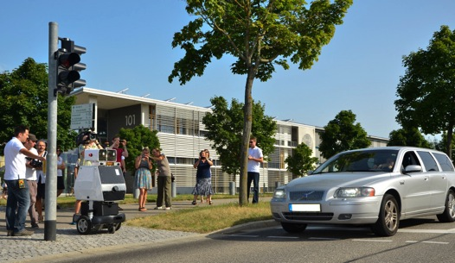
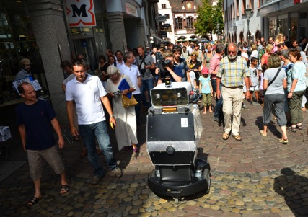
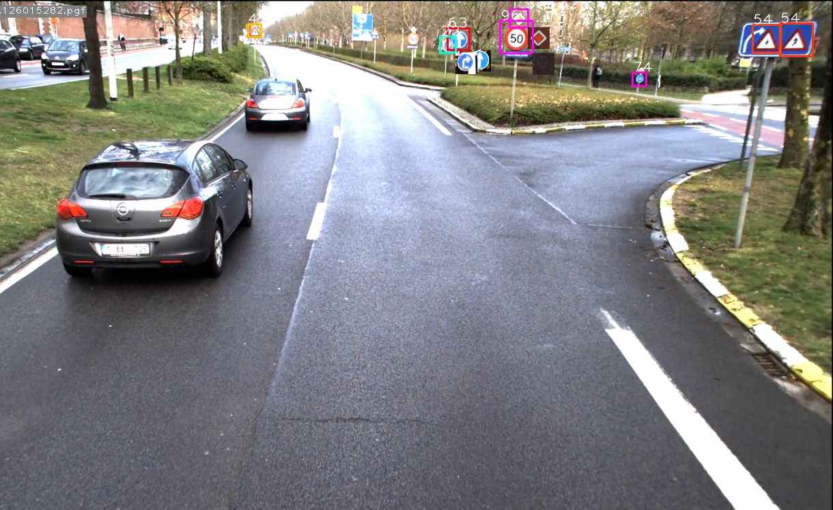
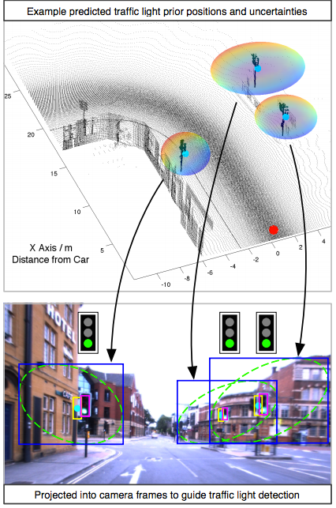
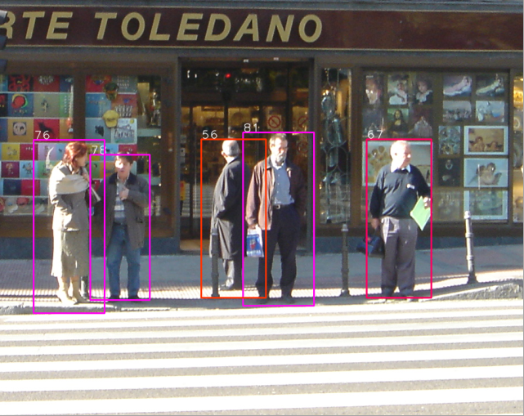
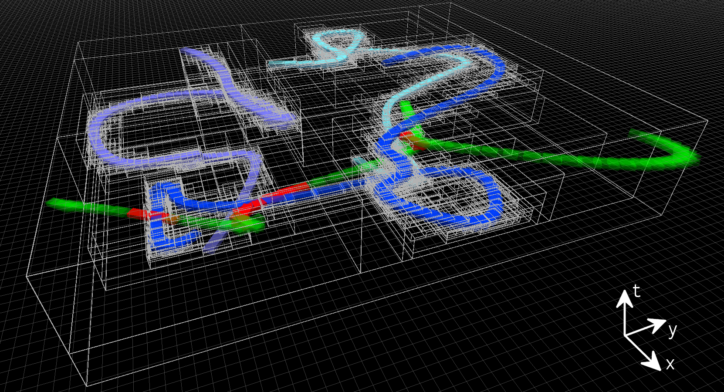

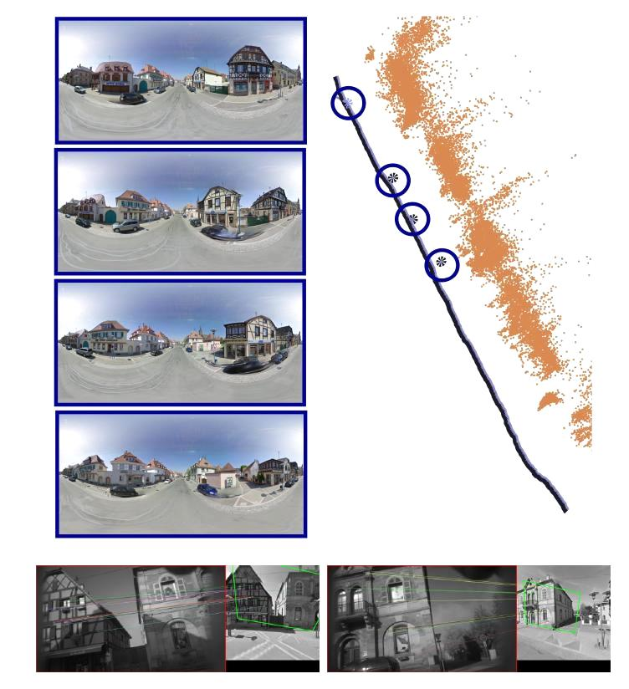
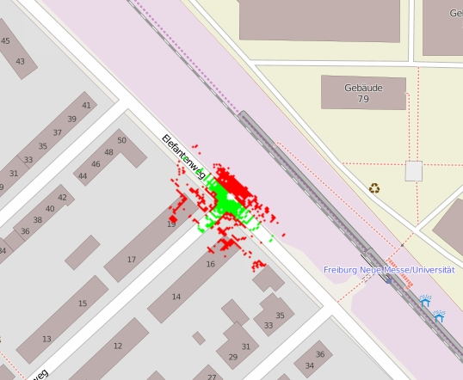
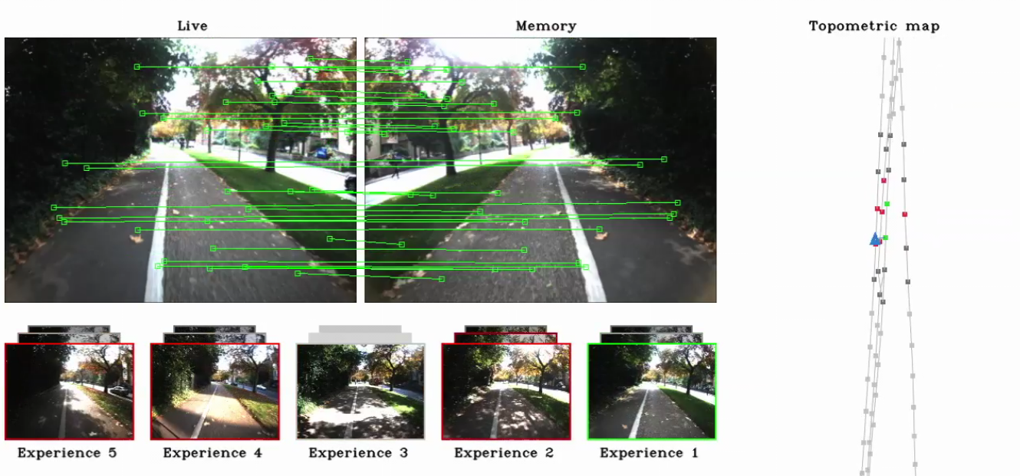
Reverse Curriculum Amadeus Hovekamp, Megan Klaiber, Hans Nübel, Rabea Turon
Project goals
Leverage publicly available maps
Online semantic scene interpretation
Socially-compatible autonomous navigation
Life-long and continuous operation
Semantic scene interpretation
Traffic sign and traffic lights recognition
Active perception exploiting location priors
Introspective classification framework
Navigation in crowded areas
People detection and tracking
Learning human interaction models
Space-time motion planning
Millimeter radar for detection of fast vehicles
Leveraging publicly available maps
Improved loop closing across seasons
Localization in Google Street View and Open Street Maps
Bootstrap navigation in Open Street Maps
Intelligent energy management
Life-long operation
Self calibration and fault detection
Experience-based navigation
Enhancing publicly available maps
Information-driven perception selection
Notes:
<Foliennummer>

